Slide 1
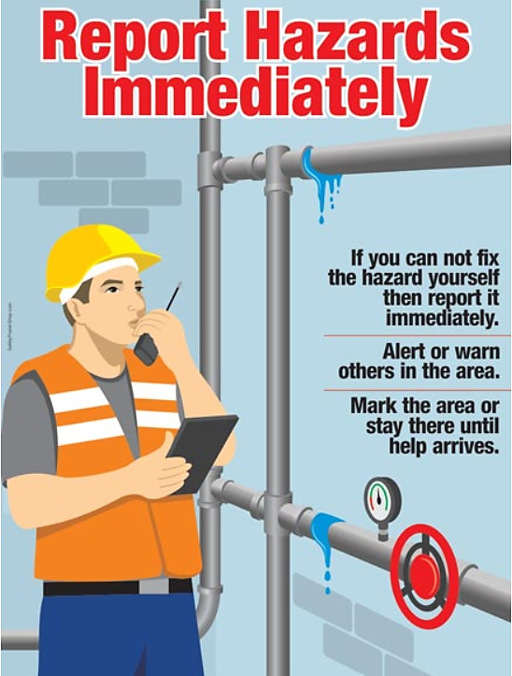
Report Hazards to the Shire’s OHS area on 5232 9415 or after hours on 0407 054 432

Slide 2
Report all incidents and near misses to the Shire’s OHS area on 5232 9415 or after hours on 0407 054 432

Slide 3
Contact: OHS Area on 5232 9415 or after hours on 0407 054 432 to report incidents at your premises

Slide 4
Report all incidents and near misses to the Shire’s OHS area on 5232 9415 or after hours on 0407 054 432

Slide 5
Report all incidents and near misses to the Shire’s OHS area on 5232 9415 or after hours on 0407 054 432

