Slide 1
Wye River & Separation Creek Building Forum
Tristan Crews
Fire Awareness & Prevention Officer
Colac Otway Shire
tristan.crews@colacotway.vic.gov.au
Mob# 0408 459 268

Slide 2
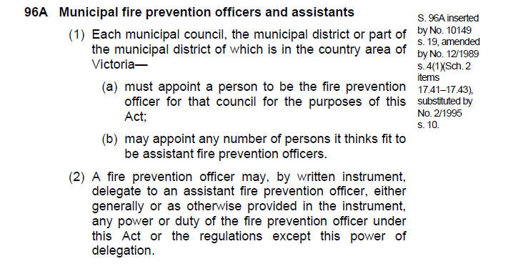
Who is the Municipal Fire Prevention Officer?
Notes:
The section above is an extract from the Country Fire Authority Act 1958 No.6228.
This just states that each municipality across Victoria must appoint a Municipal Fire Prevention Officer. At Colac Otway Shire the role is part of the overall responsibilities of the Fire Awareness Officer.
The reasoning for the role can be traced back to the Royal Commission, by Judge Stretton, in to the January 1939 fires that swept across vast areas of Victoria.
“take all practicable steps to prevent the occurrence of fire on any land vested in it and to acquire such apparatus as may be necessary for the purpose”.
Originally known as the “proper officer”.

Slide 3
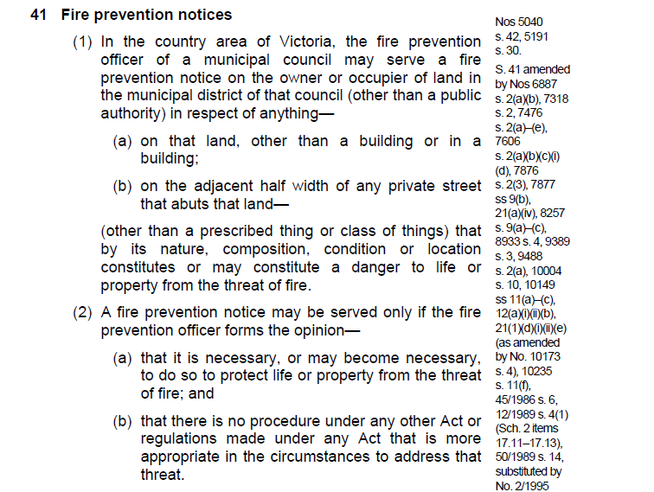
What is a Fire Prevention Notice?
Notes:
The section above is an extract from the Country Fire Authority Act 1958 No.6228.
This provides the officer with the power to (at any time) direct the removal of fire hazards on private property (not a public authority) within the shire. It requires the officer to form an opinion that without the removal of the hazards that there is, or maybe, a threat to life or property.
Key words – nature, composition (arrangement), condition or location.
Not just a subjective view, there is a prescribed process and a reliance on experience and training to assess potential level of threat to life or property.

Slide 4
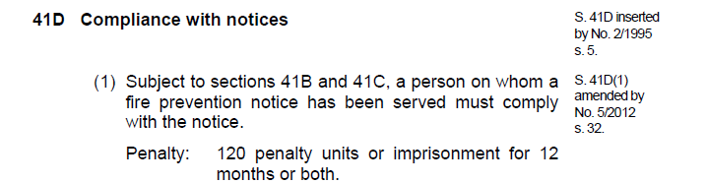
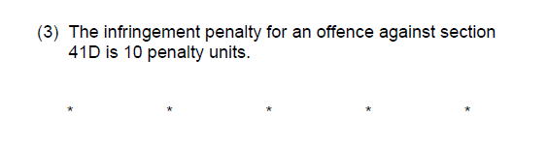
Not motivated by a Fire Prevention Notice…
Ok, so let’s do some maths.
Thanks to the Treasurer, Tim Pallas, the value of a penalty unit is now $158.57.
$158.57 x 10 units = $1585.70
$158.57 x 120 units = $19028.40
Notes:
The section above is an extract from the Country Fire Authority Act 1958 No.6228.
Section 41D is Compliance with a fire prevention notice and if a person has not complied with the notice then s41E (3) outlines the infringement for an offence against 41D.
Simply – if the FPN is not complied with it is a $1585.70 infringement. This is set high because it is a serious offence. It is also more relevant to those who won’t comply with the notice as opposed to those who can’t.
If someone makes contact with me and says, for example “I booked a contractor but is not available till after (due date)”, then we can work through that. When in doubt contact the issuing officer or shire.

Slide 5
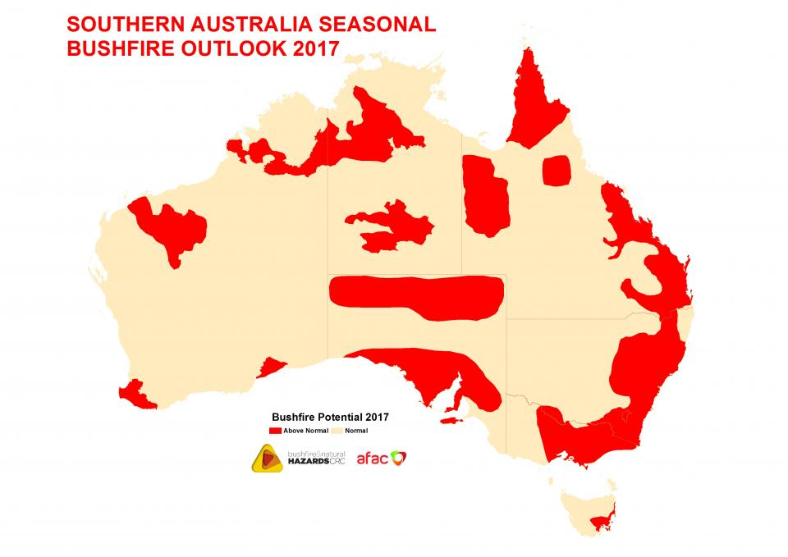
Notes:
Courtesy of the Bushfire & Natural Hazards CRC (Cooperative Research Centre).
At this time of year the inevitable question is asked, “What kind of fire season are we in for this year?”
We live in one of the most fire prone areas in the world – we are always going to be under threat.
This shows most of eastern Victoria as above normal (in red) with the rest of Victoria as normal (yellow). The change is just about though the eastern part of Colac Otway Shire and hits the coast around Apollo Bay. This is based on recent weather conditions, status of vegetation growth and fuel loads, and the potential with the long term weather forecasts to affect the current conditions.
As a result East Gippsland & Wellington Shires are both already in the declared Fire Danger Period. There is also a 8000ha (contained) fire already in the east near Buchan.
There is no news as yet on the timing for Region 6. Keep an eye on local media and http://www.cfa.vic.gov.au/warnings-restrictions/south-west-fire-district/.

Slide 6
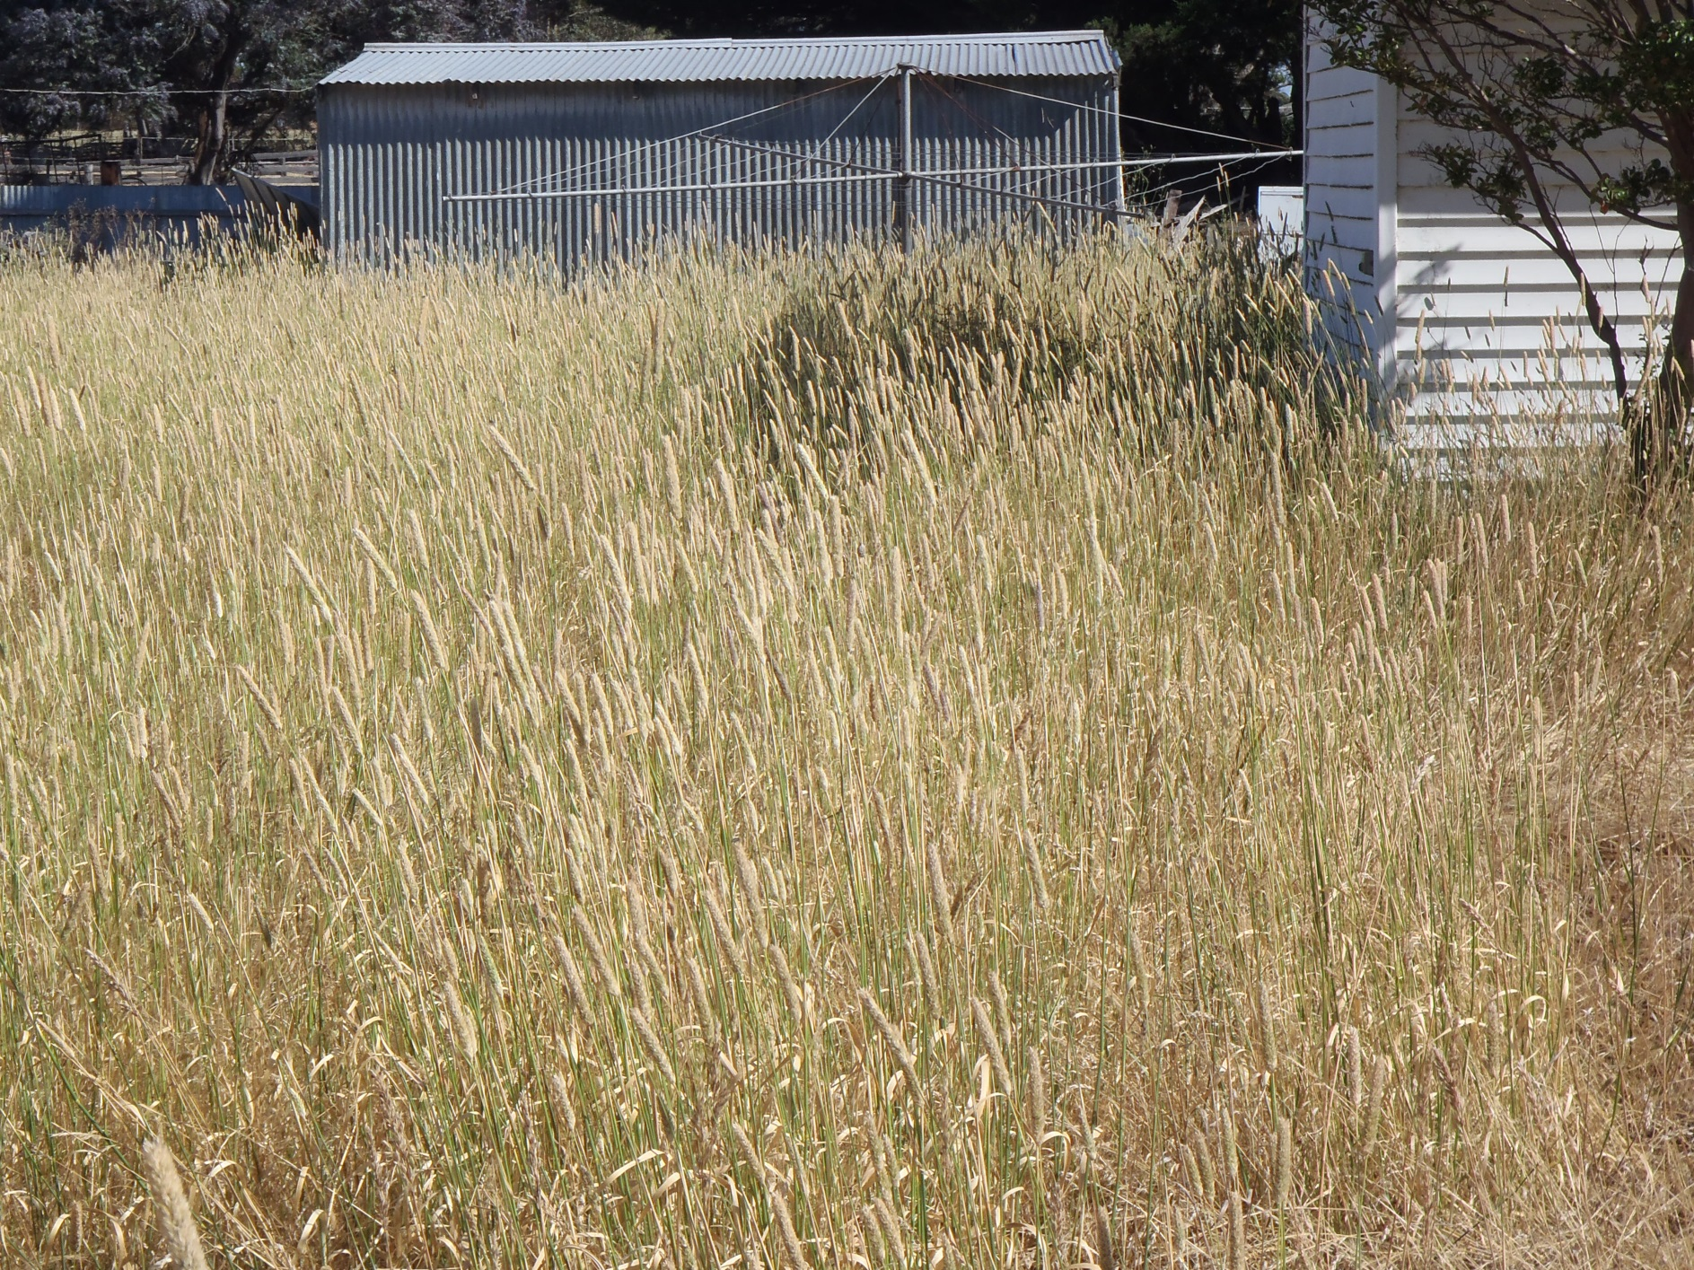
Notes:
So what will I be looking for and issuing Fire Prevention Notices for…
Yep you get a notice…

Slide 7
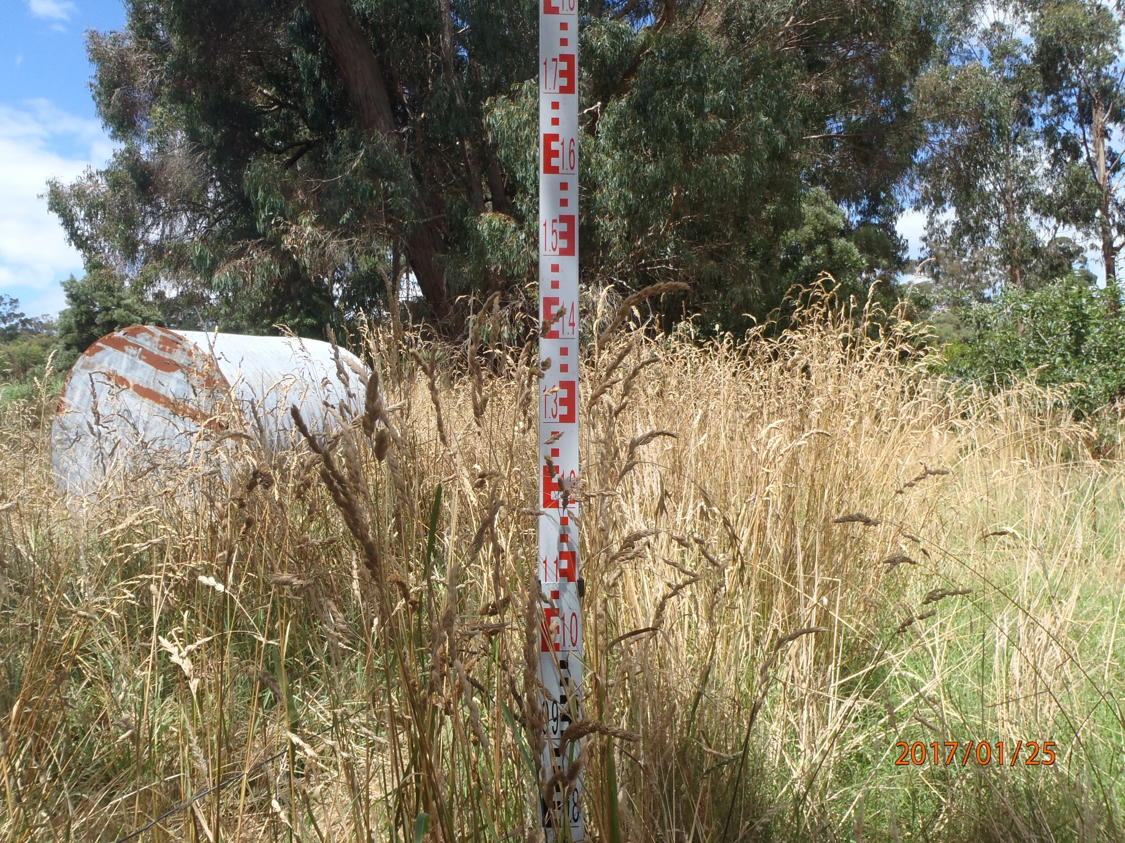
Notes:
You get a notice…

Slide 8
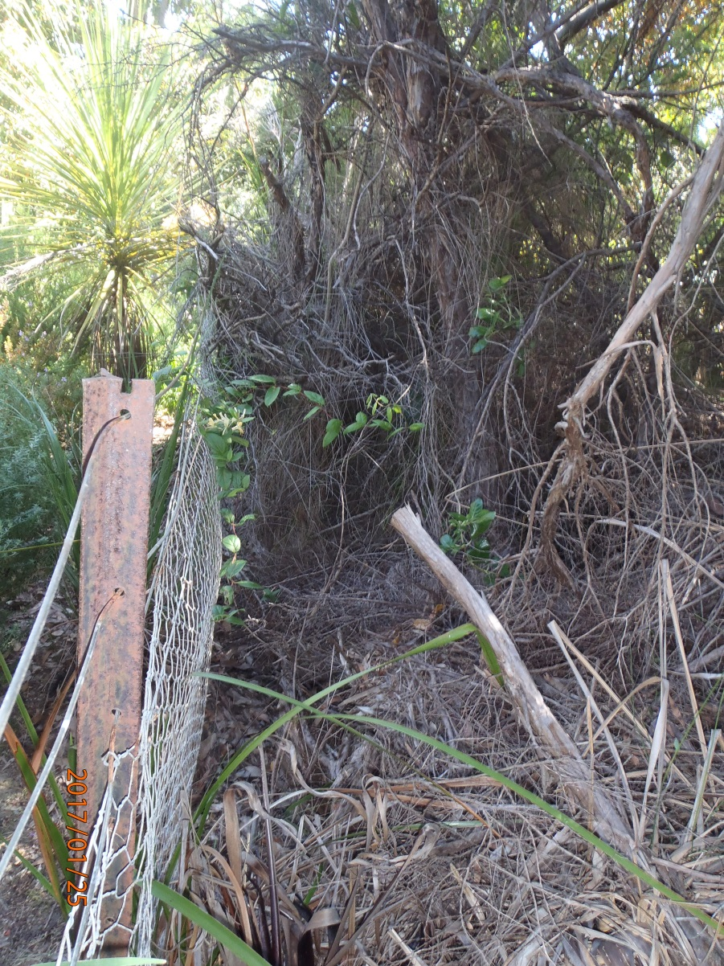
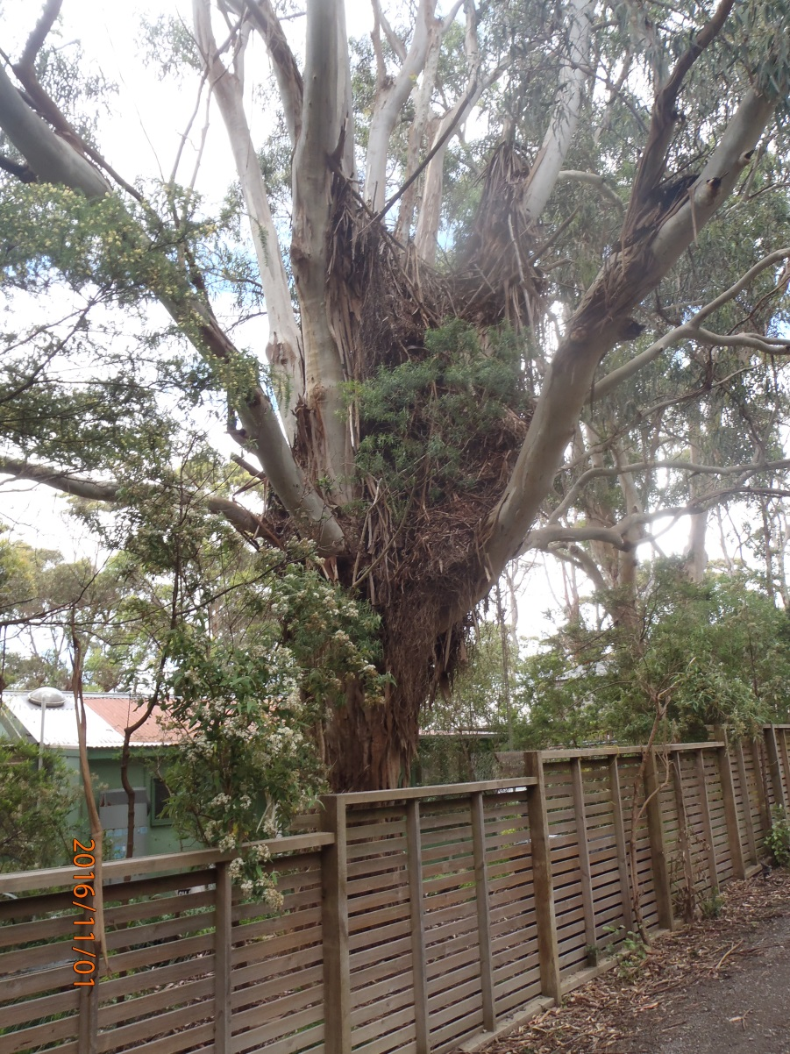
Notes:
You both get a notice…

Slide 9
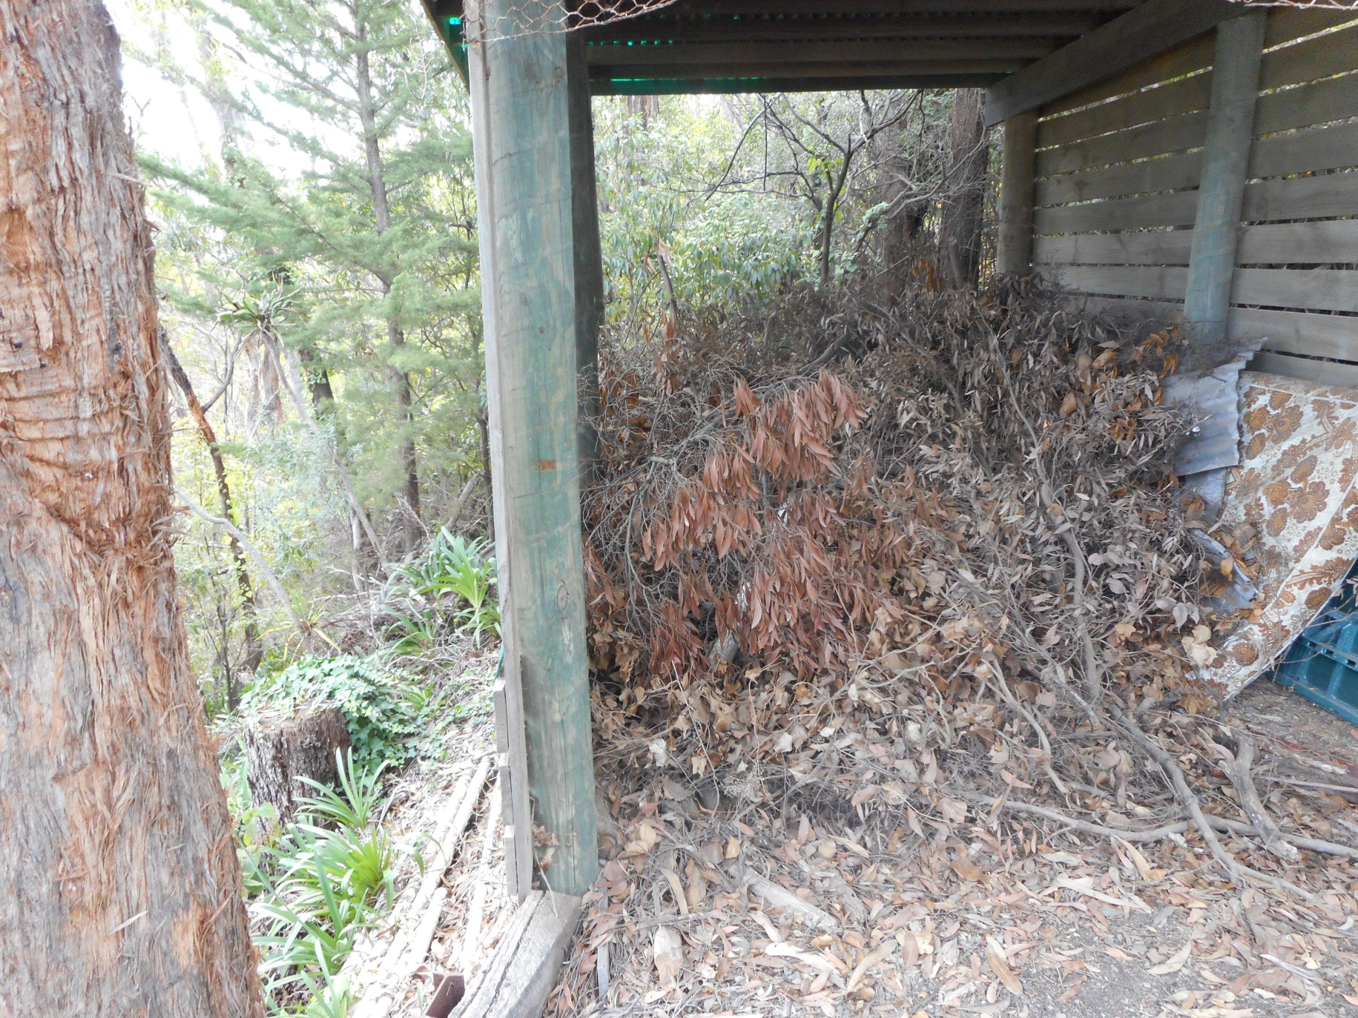
Notes:
Oh my…

Slide 10
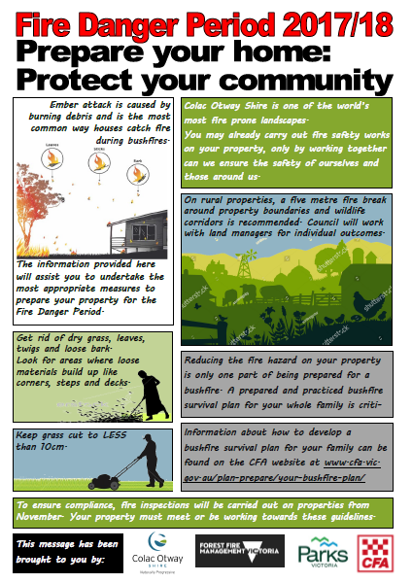
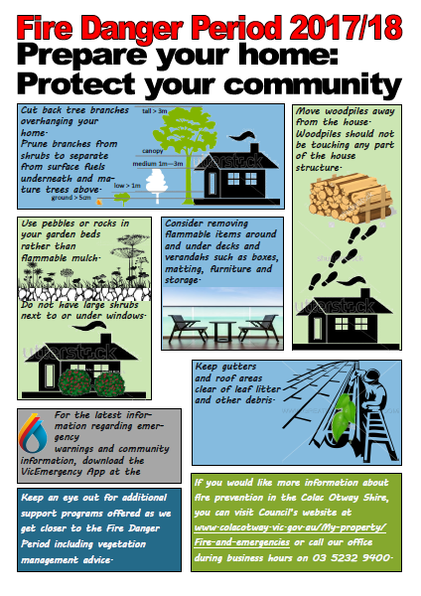
Notes:
So what can you do to prepare your property for the upcoming fire danger period. This is a good starting point. Simple straightforward advice on what you can do where you can get further information.

Slide 11
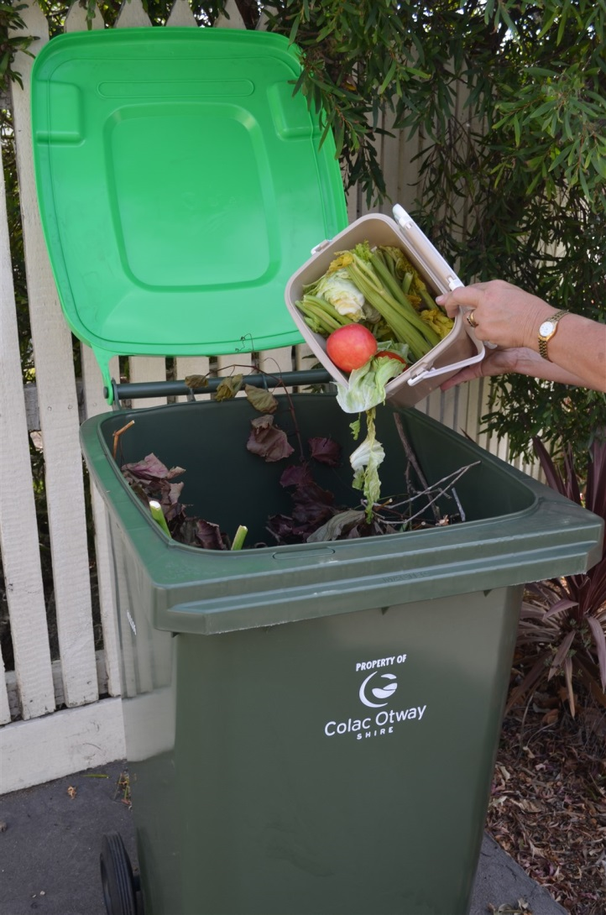
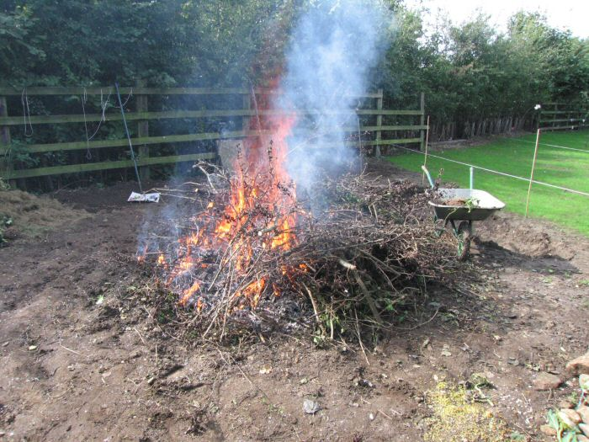
Council is offering an extra kerbside organics collection from Monday 23 October until Friday 1 December.
Free Organic Drop Off at Transfer Stations-Sunday 19 November 2017.
Further information can be found at www.colacotway.vic.gov.au
Permits required during declared Fire Danger Period.
Notes:
So what do I do with all the trimmings?
During the month of November (+ a little bit) there will be weekly green waste collections. The night you put out your normal (red lid) bin put out the green waste bin as well. Make the most of this with your preparations in the lead up to the summer fire danger period. If you don’t fill yours, allow your neighbours to top it up.
The more that properties either side are prepared the better chance for survival of all properties from the threat of a fire event. It’s like a herd immunity.
Depending on your properties location and time of year, you may need a permit to burn off. Always check with http://www.cfa.vic.gov.au/plan-prepare/burning-off/ or http://www.colacotway.vic.gov.au/My-property/Fire-and-emergencies/ before beginning.
This one above is a good example of mineral earth break and distance from other vegetation. This is the preferred upper limit on size, 2m x 2m and no more than 2m in height.

Slide 12
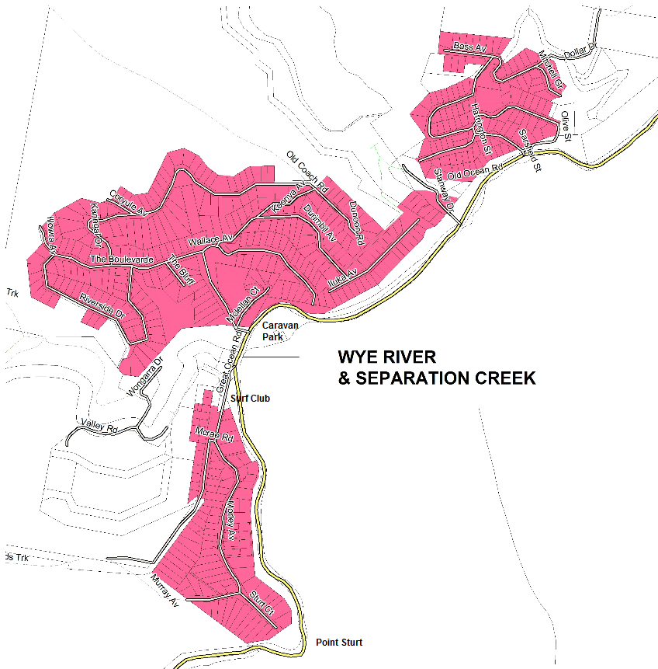
Designated Township Area
Notes:
Properties within the pink shaded area are within the Designated Township Area. It is here that the Local Law #2 applies in relation to burning off vegetation.
Fire In Open Air and Incinerators Specifically
65. Subject to clause 66, a person must not, in a Designated Township Area unless given permission to do so by an Authorised Officer;
65.1 light;
65.2 allow to be lit; or
65.3 allow to remain alight
a fire in the open air or in an incinerator on any day, other than a Friday or Saturday between the hours of 10.00am and sunset.
Penalty: A Maximum of 10 Penalty Units
Fire Danger Days
67. Nothing in clause 66 authorises a person to light a fire or allow to be lit or remain alight, or exempts a person from complying with clause 65 in respect of lighting a fire or allowing a fire to be lit or remain alight, if the fire is or has been lit:
67.1 during a Fire Danger Period;
67.2 on a Total Fire Ban Day; or
67.3 on an EPA Alert Day.
Penalty: A Maximum of 10 Penalty Units
With the differences in conditions across the Shire there may be an opportunity to have some permits issued for burning off where it is safe and necessary.
Please refer to http://www.cfa.vic.gov.au/plan-prepare/burning-off/ or http://www.colacotway.vic.gov.au/My-property/Fire-and-emergencies/ for further details about how to burn, conditions that may apply or permits that may be required.

Slide 13
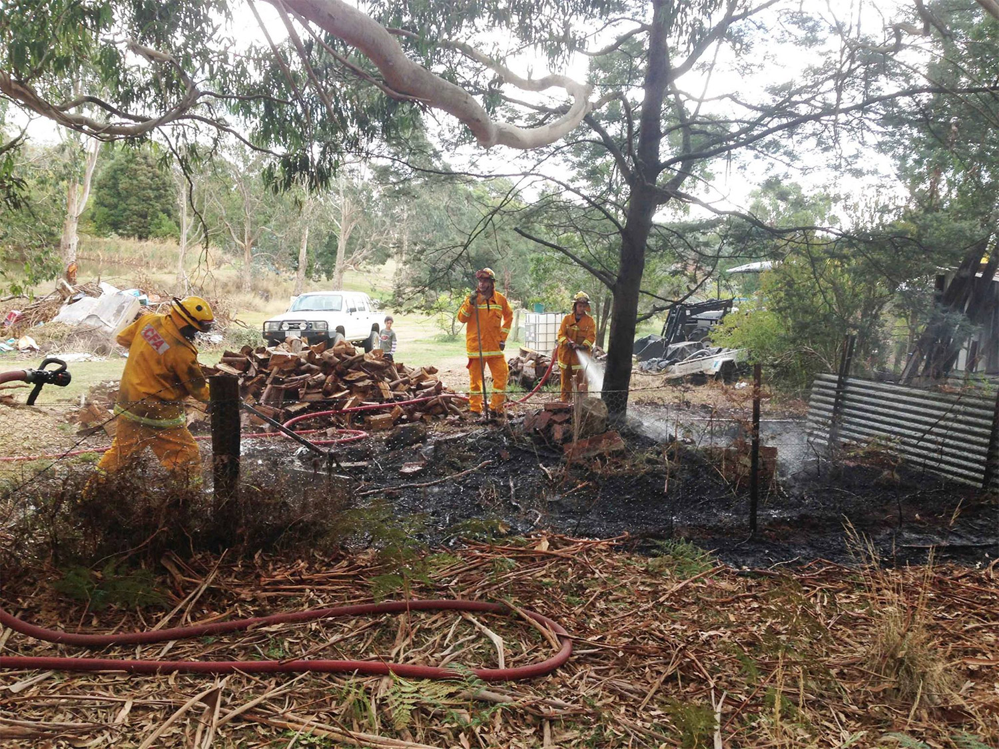
What's wrong with this picture?
Notes:
Unregistered burn-offs can cause CFA brigades to be called out unnecessarily. And it is not just unregistered burns, poorly prepared or unattended fires can turn from fuel reduction burns to a house reduction burn!
No vertical or horizontal fuel breaks – no water supply – no supervision – too much fine surface fuel (the ribbon bark & grass) – too much heavy fuel (the tree and woodpile!).
Before burning off:
Check and follow local regulations or laws set down by CFA or your local council.
Notify neighbours at least two hours before starting the burn.
Notify the Emergency Services Telecommunications Authority (ESTA) on 1800 668 511.
Check the weather forecast for the day of the burn and a few days afterwards.
Check the fuel moisture conditions.
Establish a fire break of no less than three metres cleared of all flammable material (including vertically).
Make sure there are enough people to monitor, contain and extinguish the burn safely and effectively.
ABUNDANCE OF WATER.
Register your burn-off
All burn-offs should be registered with ESTA on 1800 668 511.

Slide 14
