Slide 1
Colac Otway Building Forum
Wye River Background and the Erosion Management Overlay (EMO)
Tony Miner¹
22nd October 2017
(1 - Principal Geotechnical Engineer, A.S.Miner Geotechnical)

Slide 2
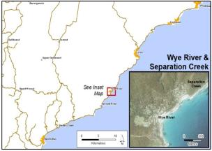
Wye River and Separation Creek _Background
Coastal townships of Wye River and Separation Creek are located in small estuaries on the SE flanks of the Otway Ranges in SW Victoria,
Approximately 160 kms south west of Melbourne - 2.5 hr drive.
The surrounding terrain is rugged with ridges and spurs separated by deeply dissected steep valleys.
Majority of the region is Public Land forested with tall eucalyptus species.
Temperate climate with warm
dry summers and cool wet winters,
Geology is Cretaceous age deposits of
the Otway Group- sandstone, mudstones
and siltstones.
Otway Ranges considered one of the
most susceptible areas to landslides .

Slide 3
LIDAR based DEM of Wye River and Separation Creek

Slide 4
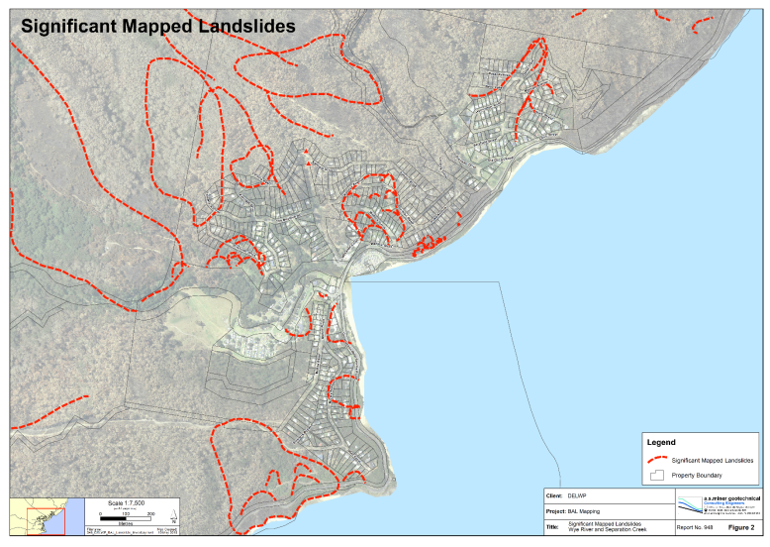
Wye River and Separation Creek
old rock slide, very large ( >10 million m³ )
old debris slide, very large ( >600,000 m³ )
recent rockfalls very small to large (0.1m to >1.0 m)
recent debris slides and flows , very small (20 m³ )
Old rock slide large (20,000 m³ ) but with relatively recent reactivation at headscarp
recent earth/debris slide, small (120 m³ )
Recent/old rock slide medium, small
(1600 m³ )

Slide 5
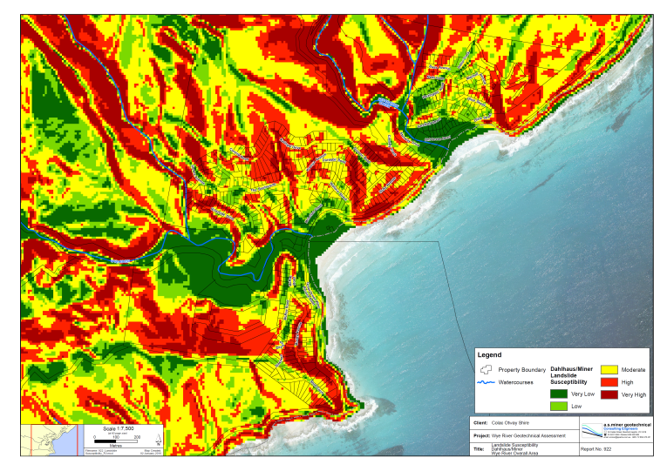
Inherent Slope Stability Issues
An early assessment of Landslide Susceptibility.
(Dahlhaus and Miner 2002)

Slide 6
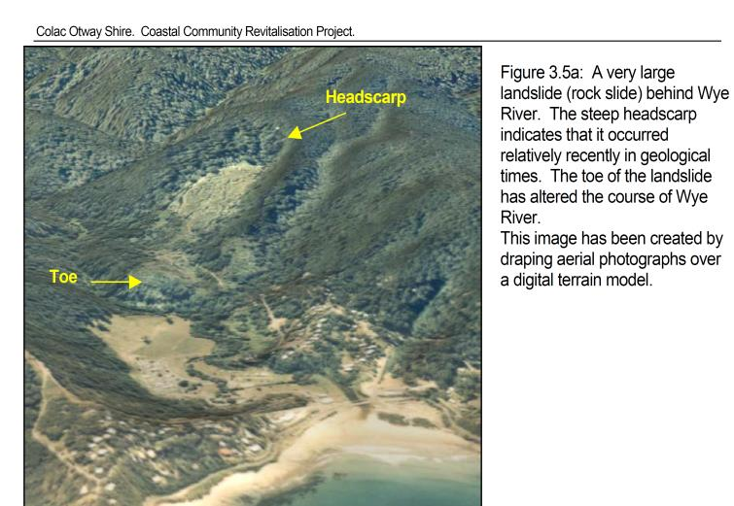
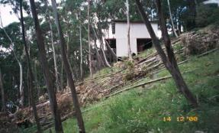
“Potato Patch” Rock Slide, Wye River
Dunoon Av

Slide 7
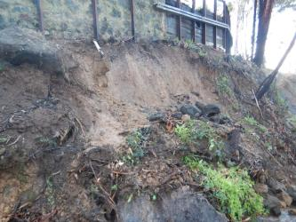
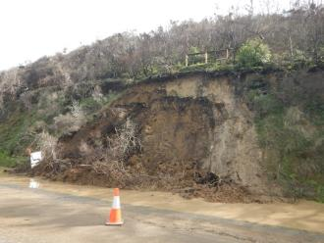
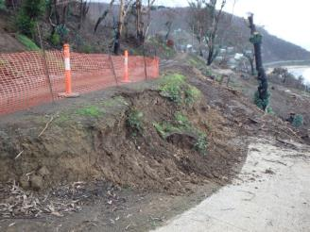
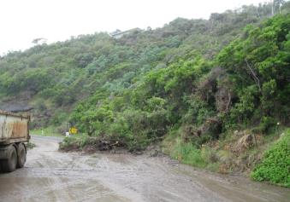
Examples of slides in Wye and Sep Creek

Slide 8
Victorian Planning Process relating to Landslide Issues
To fulfil requirements under the State Planning Policy Framework (SPPF) , Colac Otway Shire is obliged to
  Identify areas subject to erosion or instability (landslides) in planning schemes and when considering the use and development of land.
  Prevent inappropriate development in unstable areas or areas prone to erosion.
  Promote vegetation retention, planting and rehabilitation in areas prone to erosion and land instability as a duty of care to ensure appropriate development
COS uses tools within the Local Planning Policy Framework (LPPF) such as zones, overlays and particular local provisions written into schedules
Landslide is usually dealt with under the Erosion Management Overlay (EMO)

Slide 9
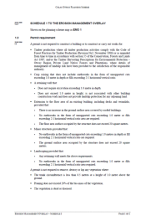
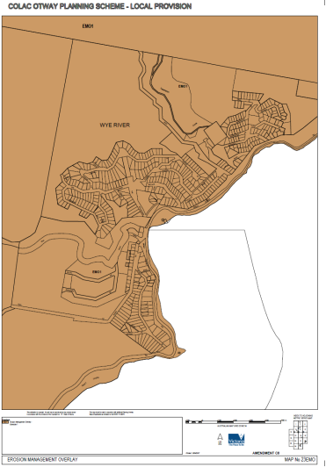
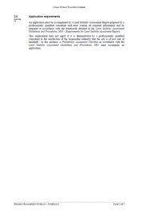
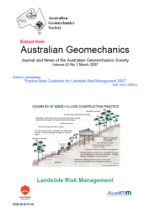

Colac Otway –EMO Schedule, Overlay and Referred Documents
Notes:
Currently the planning schedule is quite short but has referral to detailed procedures manual. Thsi has been a point of conjecture for COS for some time over the years and also with SOYR.
Just a different way of includng detail
QLD have all their detail attache dto the constraintes code.

Slide 10
Colac Otway –EMO Schedule, Overlay and Referred Documents
2_What do I have to do??
1_Where it applies??
3_How is LRA done??
Notes:
Currently the planning schedule is quite short but has referral to detailed procedures manual. Thsi has been a point of conjecture for COS for some time over the years and also with SOYR.
Just a different way of includng detail
QLD have all their detail attache dto the constraintes code.

Slide 11
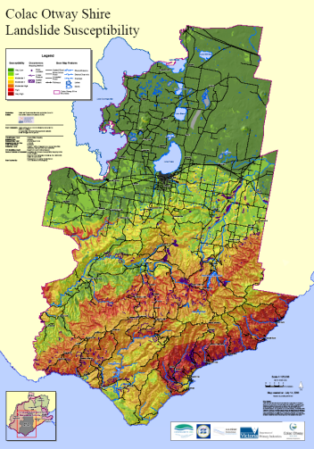
Colac Otway – Susceptibility Mapping and The Overlay
Notes:
1:25,000 on individual sheets

Slide 12
COS EMO Schedule
The provisions in Schedule 1 to the EMO aim to provide a new two tiered or two level assessment process for lands included in the planning scheme map designated as EMO1. The two levels of assessment are known as:
Geotechnical Assessment (initial level or level 1)
Landslip Risk Assessment (second more detailed level or level 2)
Notes:
Much information on these aspects in AGS2007 c and d

Slide 13
COS EMO Schedule
The initial level of assessment requires a report known as a “Geotechnical Assessment”. A primary purpose of the Geotechnical Assessment is the collection of base information about the site.
The Landslide Risk Assessment requires a full risk assessment in accordance with the requirements of the Australian Geomechanics Society’s AGS2007 Landslide Risk Management Guidelines
AGS2007 is a “referred document” under the EMO
Notes:
Much information on these aspects in AGS2007 c and d

Slide 14

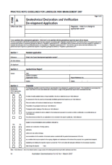
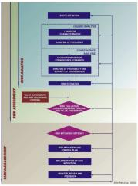
EMO Policy Requirements and AGS 2007
AGS 2007c and d provide comments on:
  The necessary competencies of practitioners
  The basic requirements of LRM reports
  Inclusion of risk to property and risk to life
  Use of preferred terminology
  Suggests use of standard forms to assist process
  Checking templates for review of reports
  Recommendations for criteria under which approvals will be given
Notes:
Much information on these aspects in AGS2007 c and d

Slide 15
Implications of Dec 2015 Bushfire for LRA reports
Superimposed on the pre-existing susceptibility to landslides in these townships are the effects of the bushfires which include:
  Loss of vegetation and groundcover leading to increased soil erosion and shallow landslides
  Long term reduction in mechanical reinforcement from root systems
  Change to water balance due to loss of water tanks and destroyed septic systems
  Significantly increased surface flows
  Increased infiltration in unlined drains
  Loss of retaining structures throughout the townships

Slide 16
Implications for LRA reports - 2016 and 2017
Significantly dry summer and early autumn leading to desiccation and cracking of soils and hence pathways for infiltration
Significantly wetter (+50%) Winter and Spring leading to elevated groundwater levels within the entire landscape.
This ultimately results in a landscape more susceptible to landslides and erosion.

Slide 17
Implications for LRA reports
All Geotechnical & Landslide Risk Assessments to include explicit analysis of the post bushfire site conditions, and how these conditions have been addressed through the risk assessment.
Most commonly in an additional report section typically of a few paragraphs
A revised Fact Sheet has been developed and will be circulated to all geotechnical practitioners advising of this requirement

Slide 18
Summary
Landslide hazards and associated risks have long been recognised as being present in Wye River and Separation Creek
The Responsible Authority (COS) has a duty to ensure appropriate development under the state legislation
COS does this under the State Planning Provisions (SPPS) using the Erosion Management Overlay.
The EMO overlay has a mapping component, a written schedule and referred documents
Requirements are contained both within the schedule and the referred documents (i.e. AGS2007)
Implications from the Dec 2015 bushfire have meant even further review of submitted reports is being undertake.

