Slide 1
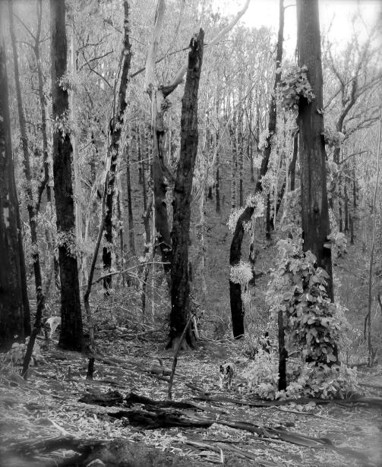
PLANT SELECTION, ARRANGEMENT AND MANAGEMENT TO HELP MINIMISE YOUR RISK FROM BUSHFIRE.
IS IT TIME TO RECONSIDER YOUR GARDEN?
Notes:
Life after death. BUSHFIRES ARE SCARY AND DAUNTING ESPECIALLY IF YOUV’E LOST EVERYTHING AND YOU HAVE TO COMPLETELY START AFRESH LIKE MANY OF YOU.

Slide 2
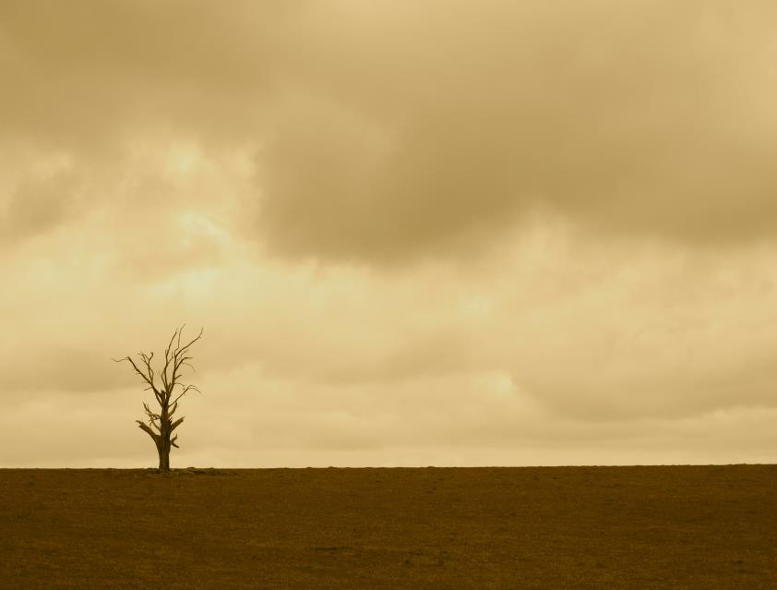
Notes:
I DON’T KNOW ABOUT YOU, But I don’t want to live here. Some people think that living in a treeless environment will totally assure you of no fires.

Slide 3
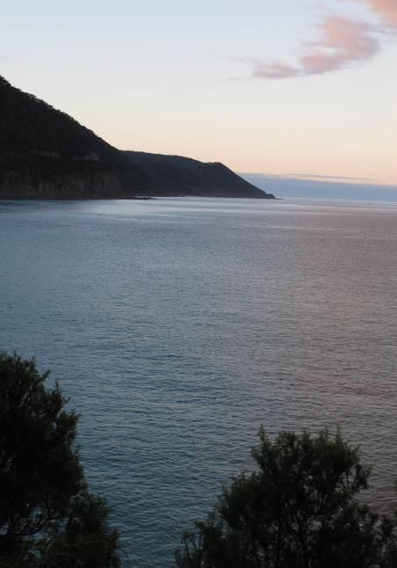
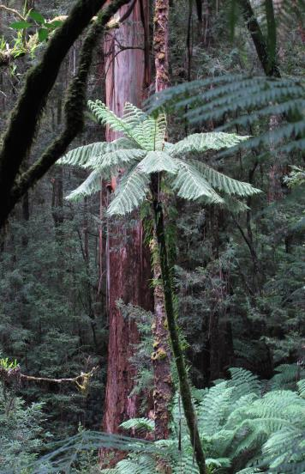
Notes:
I live in the Otways because of its natural beauty, wet forests ocean etc. I have weighed up the risks and I still want to live here. But Victoria is one of the most fire prone areas in the world. If we want to live here we have to arm ourselves with knowledge and actually work for the privilege of living here.

Slide 4
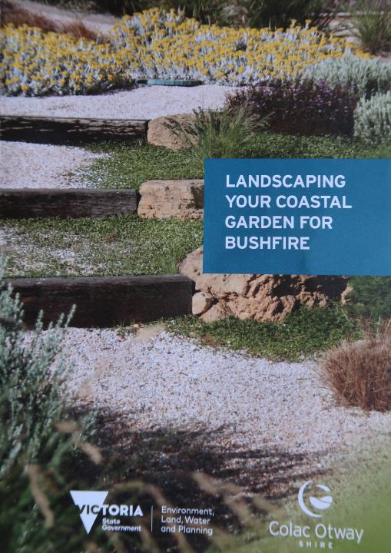
Notes:
SO LET’S USE THIS BOOKLET TO Cover a few simple design plans to HELP reduce fire risk in the bush garden

Slide 5
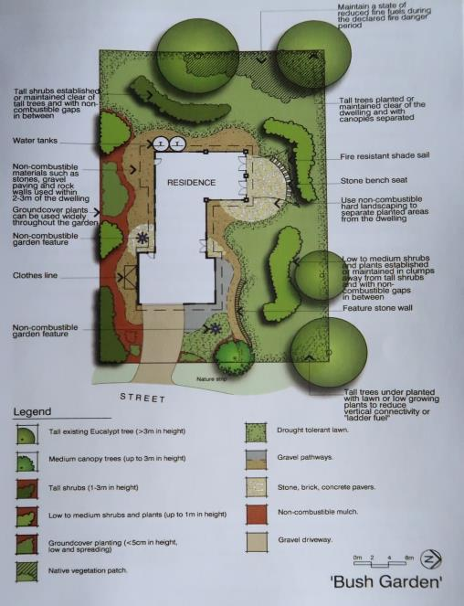
GARDENS NEED TO BE MANAGED:
Planning
Thinning
Pruning
Lopping
Coppicing
Clearing
Weeding
Gravelling
Watering
Renewing

Slide 6
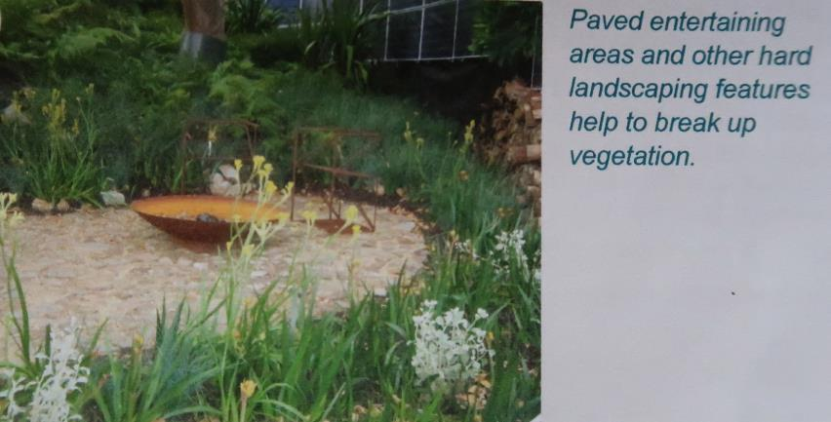
Well managed and watered gardens reduce dry burnable material, decrease fuel load and fire intensity.
Notes:
Decrease fire intensity by have less fuel load, fire wood stack a no no. Plants need to be maintain

Slide 7
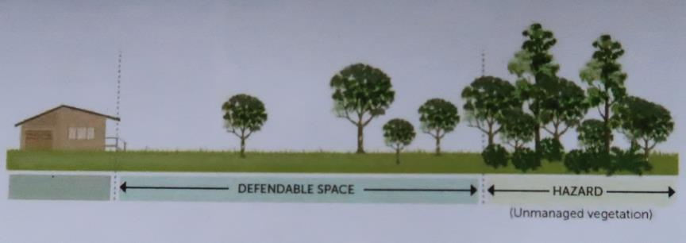
VEGETATION CAN SLOW THE WIND AND TRAP EMBERS BUT MAKE SURE THE VEGETATION IS NOT TOO CLOSE TO THE HOUSE
Notes:
FILTERS WIND, EMBER TRAP

Slide 8
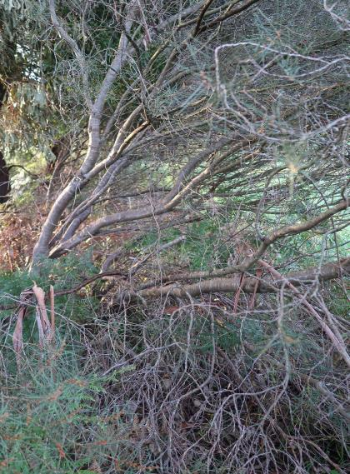
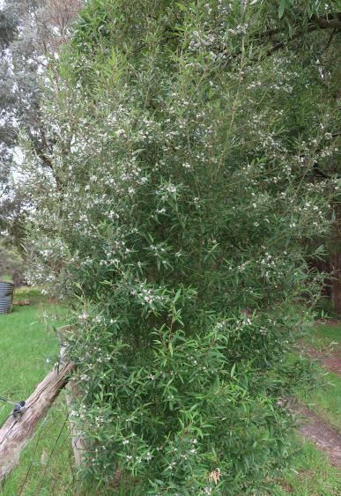
SATINBOX
NEMATOLEPIS SQUAMEUM
MANAGE VEGETATION FOR FIRE- LIVING FOLIAGE TAKES LONGER TO IGNITE THAN DEAD FOLIAGE. CHOOSE PLANTS THAT RETAIN LIVING FOLIAGE TO THE GROUND.
Notes:
Basically I’m just going to touch on two important aspects of what you can do as a landowner to help minimise risk of fire near your house.

Slide 9
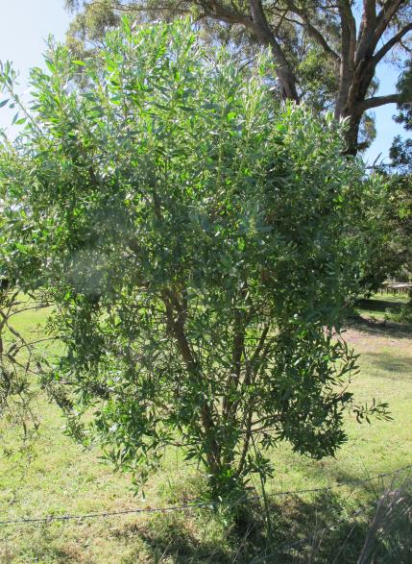
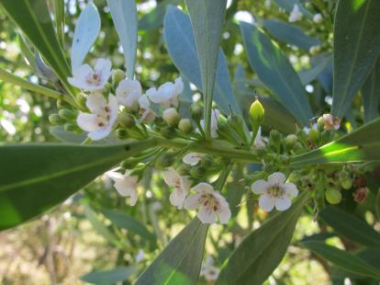
FIREWISE PLANT: COASTAL BOOBIALLA- MYOPORUM INSULARE. SUCCULENT LEATHERY LEAVES ON 4M TALL AND WIDE SHRUB.
EXCELLENT SMALL SCREEN AND EMBER TRAP.
Notes:
TWO EXAMPLES OF FIREWISE PLANTS. FOR THOSE WITH COASTAL EXPOSURE- BOOBIALLA

Slide 10
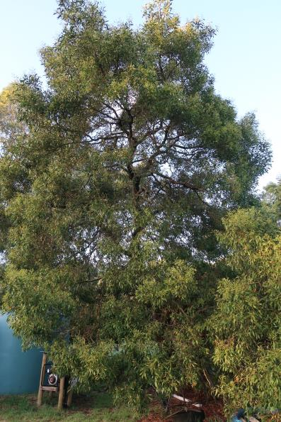
FIREWISE PLANT: BLACKWOOD -ACACIA MELANOXYLON IS A GREAT LOCAL SCREEN TREE AND EMBER TRAP. VERY FEW DEAD BRANCHES, NO VOLATILE OILS IN THE LEAVES, MINIMAL LEAF LITTER.
Notes:
FOR THOSE AWAY FROM THE EFFECTS OF SALT WINDS. NOT AS FIRE WISE AS BOOBIALLA AND MAY BE TOO TALL FOR SOME GARDENS.
LETS LOOK AT TALL TREES THAT ARE ALREADY IN YOUR GARDEN.

Slide 11
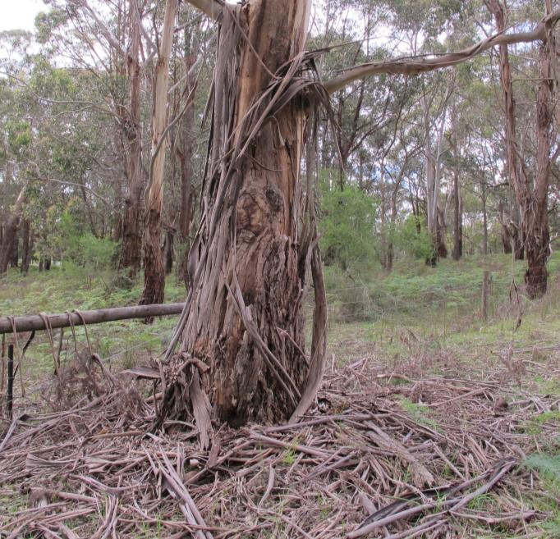
LADDER EFFECT- RIBBON BARK
EUCALYPTUS VIMINALIS MANNA GUM
Notes:
LET’S START AT GROUND LEVEL- ANNUAL BARK DROP. YOU GOTTA BE THERE TO REMOVE

Slide 12
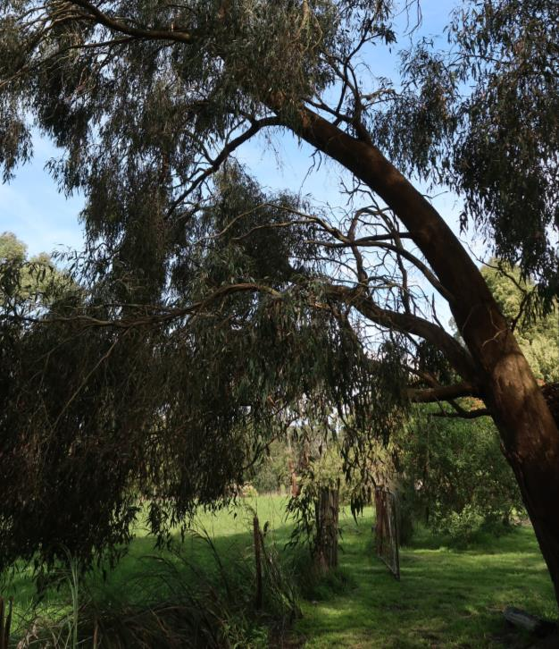
LADDER EFFECT-
HANGING BRANCHES ALSO HIGH OIL CONTENT IN LEAVES AND FIBROUS BARK
EUCALYPTUS RADIATA
NARROW LEAF PEPPERMINT
Notes:
MAYBE NOT A GOOD SPECIES CHOICE NEAR HOUSE

Slide 13
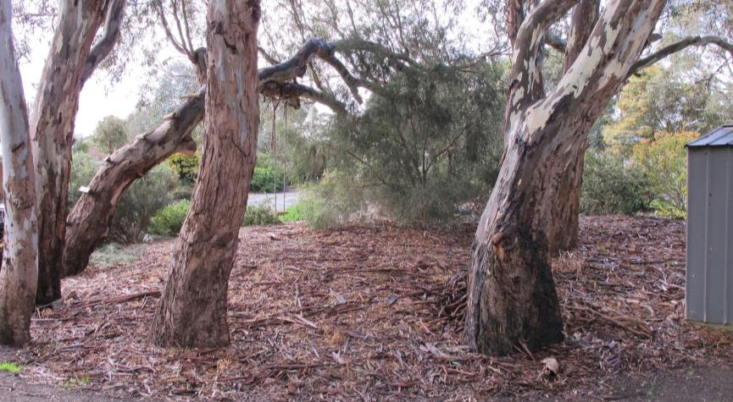
EUCALYPTUS CAMALDULENSIS- RED GUM
LADDER EFFECT- REDUCED BY PRUNING, SPECIES SELECTION AND NOT MANY SHRUBS UNDERNEATH
MULCH SELECTION IS IMPORTANT IN HIGH FIRE RISK AREAS

Slide 14
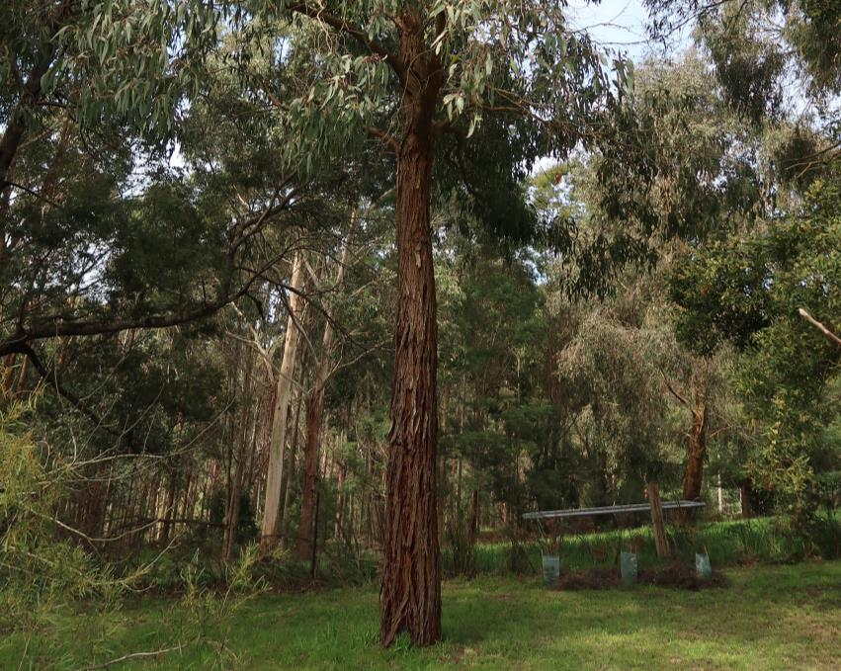
NO LITTER AT BASE, NO LADDER
EFFECT DUE TO PRUNING
STILL FLAMMABLE BUT HAS BEEN
MANAGED TO MINIMISE RISK.
EUCALYPTUS AROMAPHLOIA
APPLE BOX
Notes:
I HAVE A WHOLE TABLE FULL OF INDIGENOUS PLANTS OVER THERE. PLEASE COME UP AND HAVE A CHAT DURING THE FORUM

Slide 15
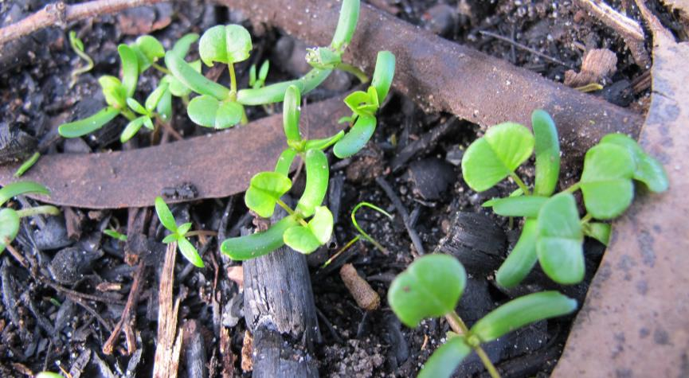
RENEWAL
Notes:
WITHIN 5 MONTHS GERMINATION WAS EVERYWHERE. PLANTS COMING UP IN PROFUSION. MOTHER NATURE PLANTS MORE THAN SHE NEEDS - STRONG ONES SURVIVE. IN OUR GARDENS WE DON’T HAVE THAT LUXURY. WE HAVE TO PLAN, PREPARE WORK HARD TO GET OUR GARDENS RIGHT TO GIVE US A FIGHTING CHANCE AGAINST WHATEVER’S ROUND THE CORNER.

